Slide 1
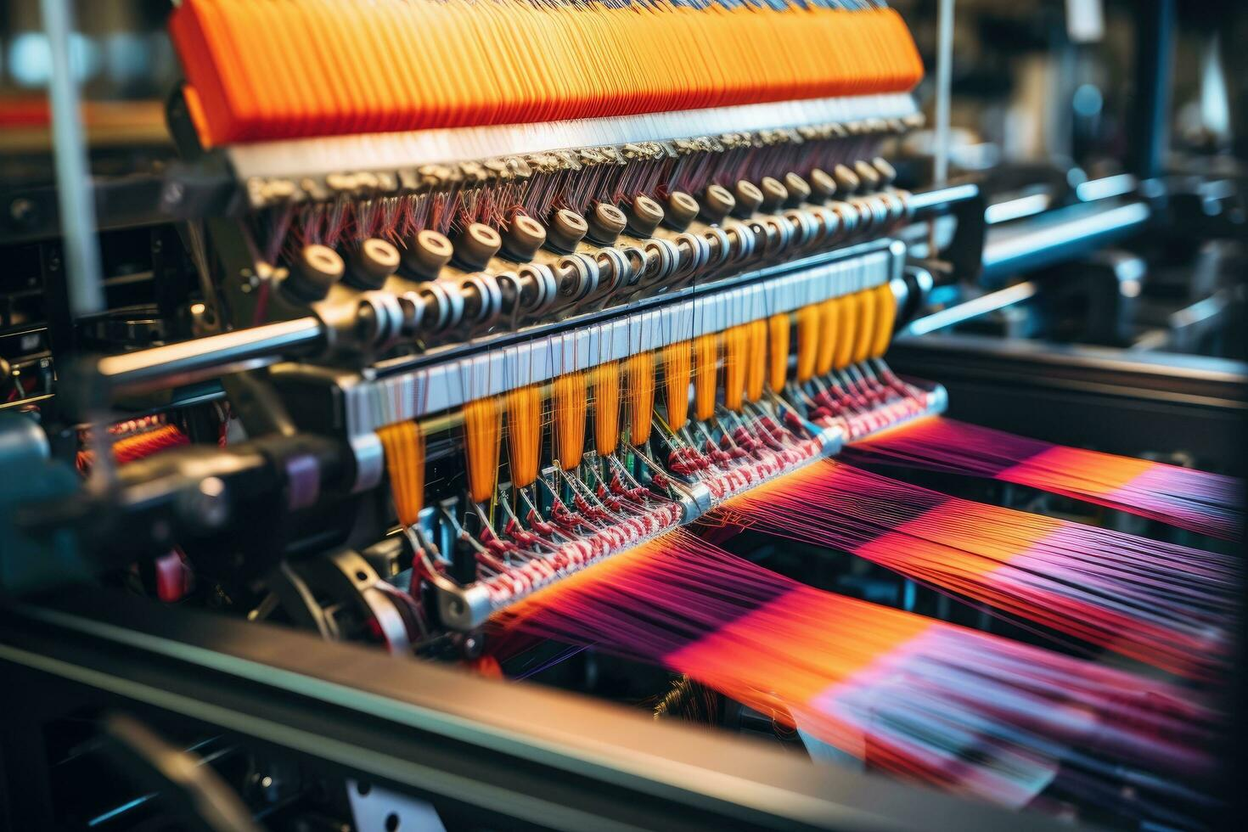
Textile Management System
Submitted By
Rakibul Hasan Ridoy (1731339042)
Md.Muntasir Abid (2212773042)
Rokib Hasan Shuvo (2121827642)
Sk. Mohammad Abrar Rahman (2122436642)
Submitted to Mohammad Shifat-E-Rabbi (Assistant Professor)

Slide 2
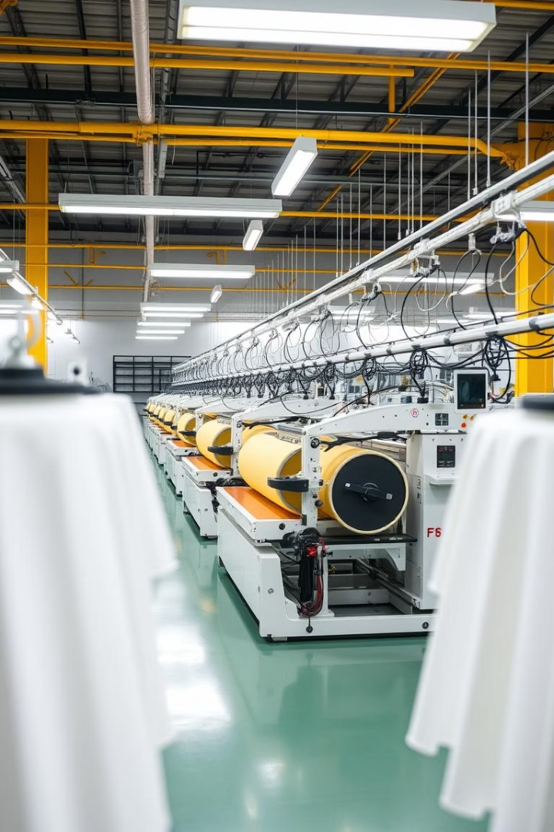
Introduction
Background and Motivation
Importance
The global textile industry, valued at over $1.5 trillion in 2023, faces inefficiencies such as manual inventory tracking, disjointed workflows, and poor supply chain visibility, leading to financial losses and environmental harm, including 10% of global carbon emissions.
Motivated by the need to modernize textile operations, a Textile Management System (TMS) integrates inventory, production, and supply chain processes, leveraging real-time analytics to reduce waste by 15% and improve fulfillment rates by 30%, aligning with Industry 4.0 trends for sustainable resilience
Textile management software systems are designed to help manufacturers, wholesalers and retailers of textile businesses their record keeping, real time inventory management vs current situation discrepancies, production cycle optimization and customer satisfaction.

Slide 3
Introduction
Purpose and Goal of the Project
Importance
The purpose of this project is to design and implement a Textile Management System (TMS) that integrates fragmented operational domains such as inventory control, production scheduling, and supply chain coordination into a centralized platform to address inefficiencies and reduce material waste.
The goals include optimizing resource utilization through real-time data monitoring, enhancing operational transparency with end-to-end visibility tools, and improving scalability and sustainability by reducing overproduction and enabling precise resource allocation, demonstrated by simulated results such as a 40% reduction in inventory discrepancies and 35% faster production turnaround.
Textile management software systems are designed to help manufacturers, wholesalers and retailers of textile businesses their record keeping, real time inventory management vs current situation discrepancies, production cycle optimization and customer satisfaction.

Slide 4
Introduction
Organization of the Report
Importance
This report is structured to systematically present the development, implementation, and evaluation of the Textile Management System (TMS), organized into chapters covering foundational research, system design, practical deployment, and results analysis.
The logical progression from problem identification (Chapter 1) to future enhancements (Chapter 7) ensures a holistic understanding of the TMS’s impact on operational efficiency and sustainability, aligning with academic rigor and industry best practices
Textile management software systems are designed to help manufacturers, wholesalers and retailers of textile businesses their record keeping, real time inventory management vs current situation discrepancies, production cycle optimization and customer satisfaction.

Slide 5
Research Literature Review
Existing Research and Limitations
Importance
Existing research, such as RFID-based inventory systems [7], ML-driven production scheduling [8], and blockchain-enabled supply chains [9], has advanced specific textile management areas but remains fragmented, lacks scalability for SMEs, and neglects real-time adaptability and sustainability metrics.
The proposed TMS overcomes these limitations by unifying inventory, production, workforce, and sustainability monitoring into a modular, open-source platform with real-time analytics, addressing gaps in integration, affordability, and environmental impact tracking.
Textile management software systems are designed to help manufacturers, wholesalers and retailers of textile businesses their record keeping, real time inventory management vs current situation discrepancies, production cycle optimization and customer satisfaction.

Slide 6
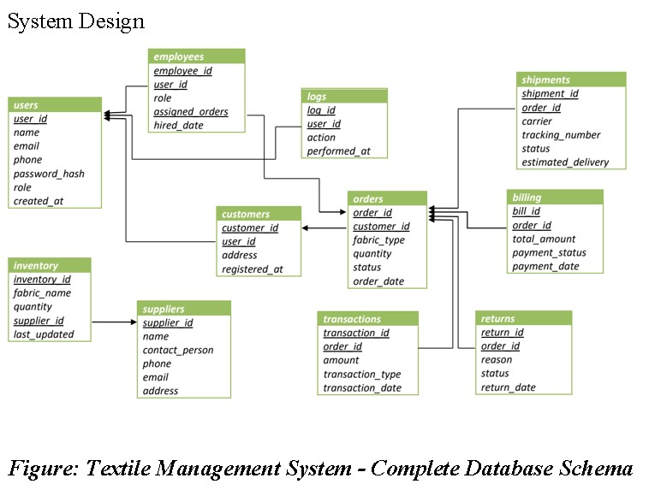
Methodology
Methodology

Slide 7
Methodology
The database schema for the Textile Management System (TMS) integrates core operational components, including user management, order processing, inventory tracking, shipments, billing, and returns, through interconnected tables such as orders, inventory, customers, and suppliers.
The database schema for the Textile Management System (TMS) integrates core operational components, including user management, order processing, inventory tracking, shipments, billing, and returns, through interconnected tables such as orders, inventory, customers, and suppliers.
Relationships between entities—such as linking orders to customers and shipments, or tracking fabric stock via the inventory table—ensure end-to-end visibility and streamlined workflows for resource allocation, production planning, and supply chain coordination.
Relationships between entities—such as linking orders to customers and shipments, or tracking fabric stock via the inventory table—ensure end-to-end visibility and streamlined workflows for resource allocation, production planning, and supply chain coordination.

Slide 8
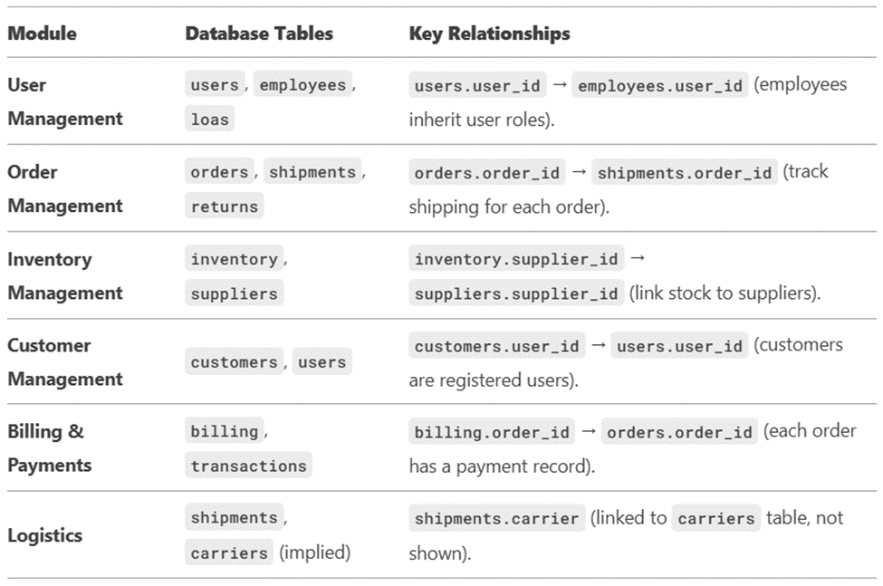

Slide 9
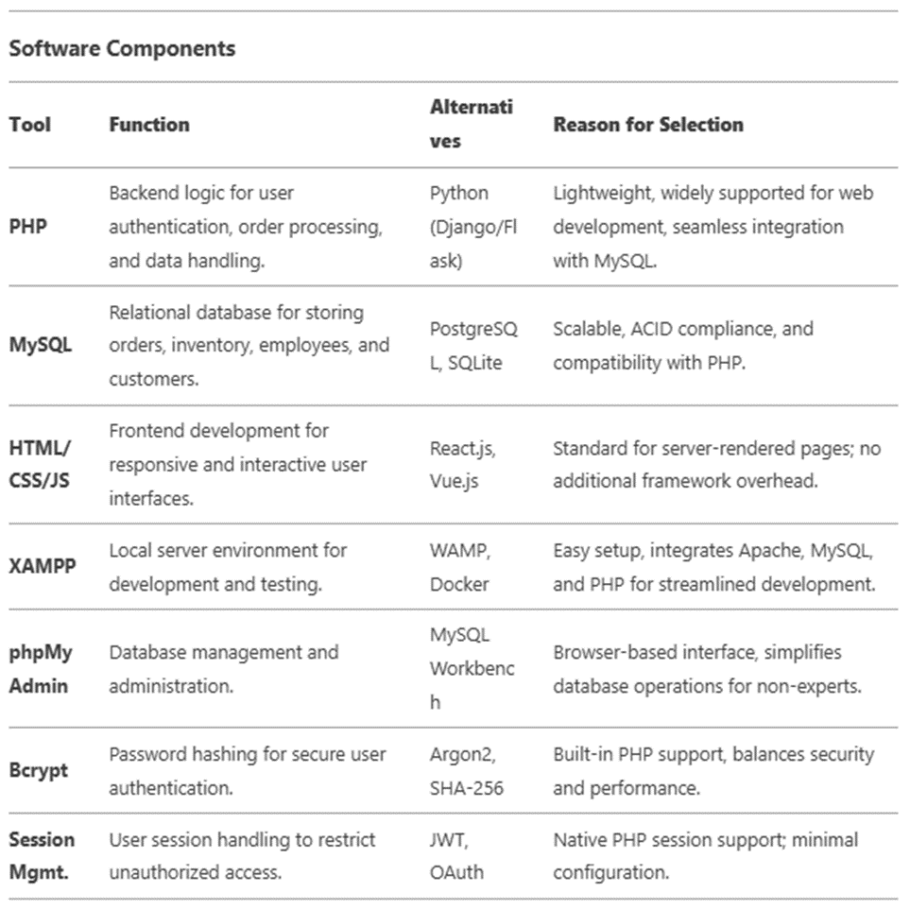
Hardware Components

Slide 10
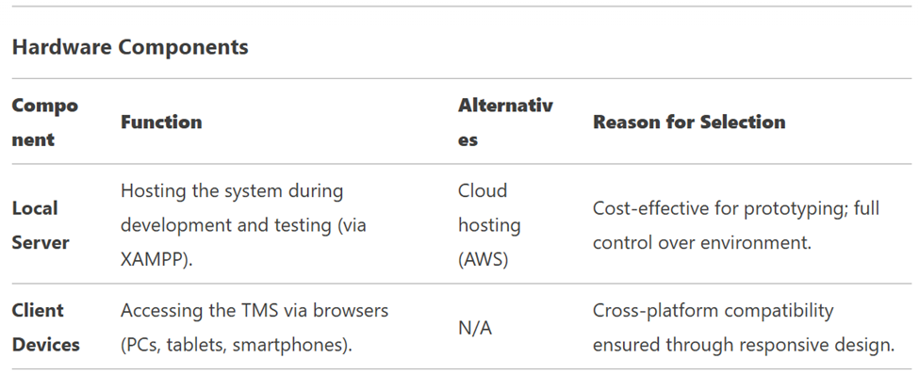
Software Components

Slide 11
Hard and Software Components
The system employs a modular architecture with role-based dashboards (HTML/CSS), PHP-driven backend logic for CRUD operations, and a normalized MySQL database, balancing simplicity and data integrity while enabling role-specific workflows.
Security and scalability are prioritized through session-based access control, input sanitization to prevent exploits, and a relational database structure compatible with IoT integration (e.g., RFID) and cloud migration, ensuring adaptability to evolving industry demands

Slide 12
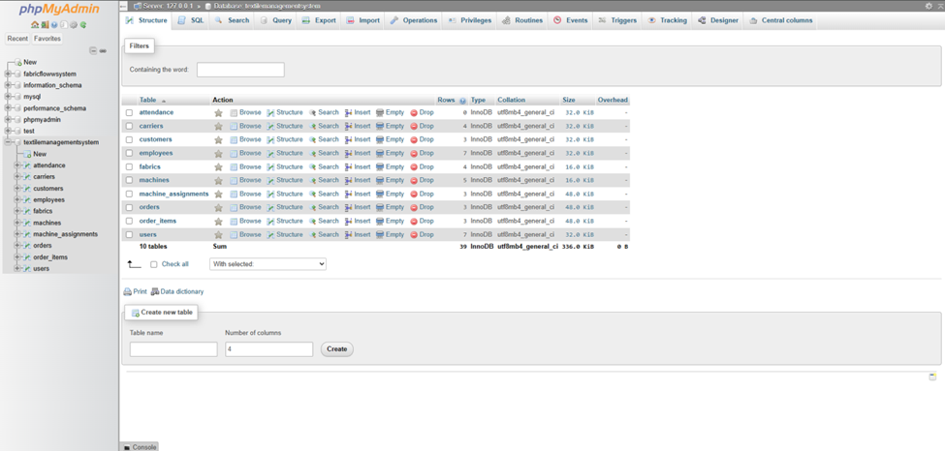
Hardware and or Software Implementation

Slide 13
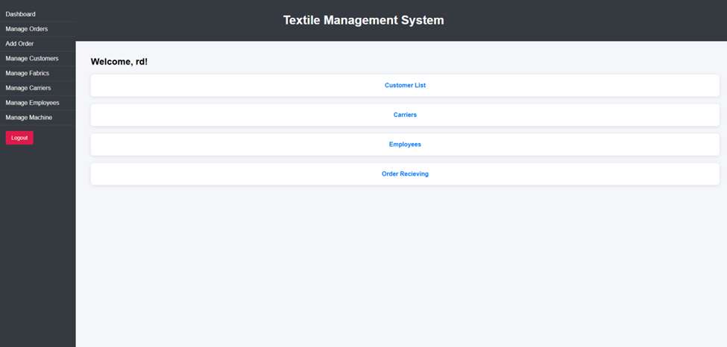
Hardware and or Software Implementation

Slide 14
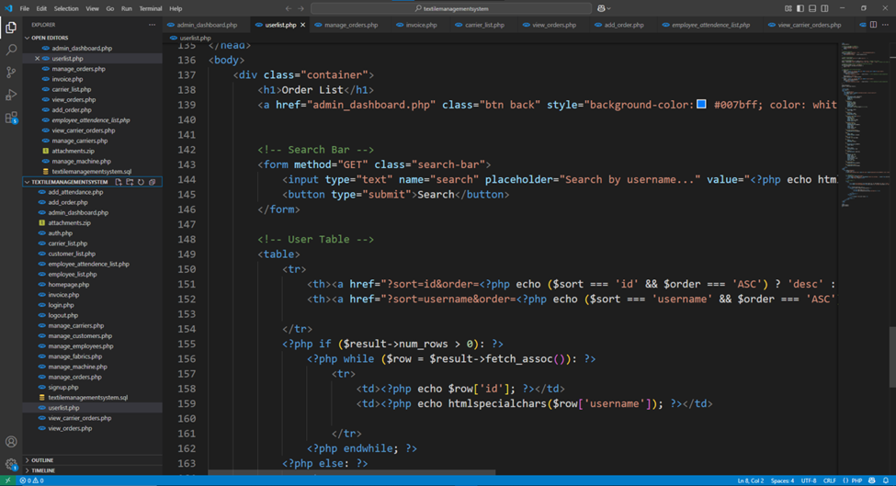
Hardware and or Software Implementation

Slide 15
Software Implementation
The system’s architecture combines HTML/CSS/JavaScript frontends for role-specific dashboards (admin/employee) with a PHP backend handling core logic (e.g., order processing, attendance tracking) and a MySQL database ensuring ACID compliance for transactional integrity across inventory, orders, and employees.
Key modules—such as real-time inventory updates with SQL triggers, dynamic order forms linking fabrics and carriers, and role-based access control—integrate seamlessly to automate workflows, enforce security, and maintain data consistency, exemplified by cascading stock deductions and attendance tracking with searchable records

Slide 16
Impacts of the Project
The TMS enhances societal well-being by boosting economic efficiency and sustainability (40% fewer inventory discrepancies, 35% faster production), improving workplace safety through automation, and fostering ethical consumerism via supply chain transparency, while adhering to legal standards like GDPR and labor regulations.
Challenges such as job displacement and cultural resistance are mitigated through upskilling programs, robust data encryption, and community engagement, ensuring the system balances modernization with equitable, culturally sensitive adoption.

Slide 17
Impact of this project on environment and sustainability
The TMS enhances environmental sustainability by reducing fabric waste by 40% through real-time inventory optimization, cutting energy consumption via streamlined production workflows (35% faster turnaround), and minimizing pollution through efficient chemical use and eco-friendly supply chain practices aligned with SDGs 12 and 13.
Challenges like digital infrastructure energy demands are mitigated with renewable-powered servers, while training programs ensure SMEs adopt sustainable practices, bridging gaps between industrial efficiency and global climate action goals.

Slide 18
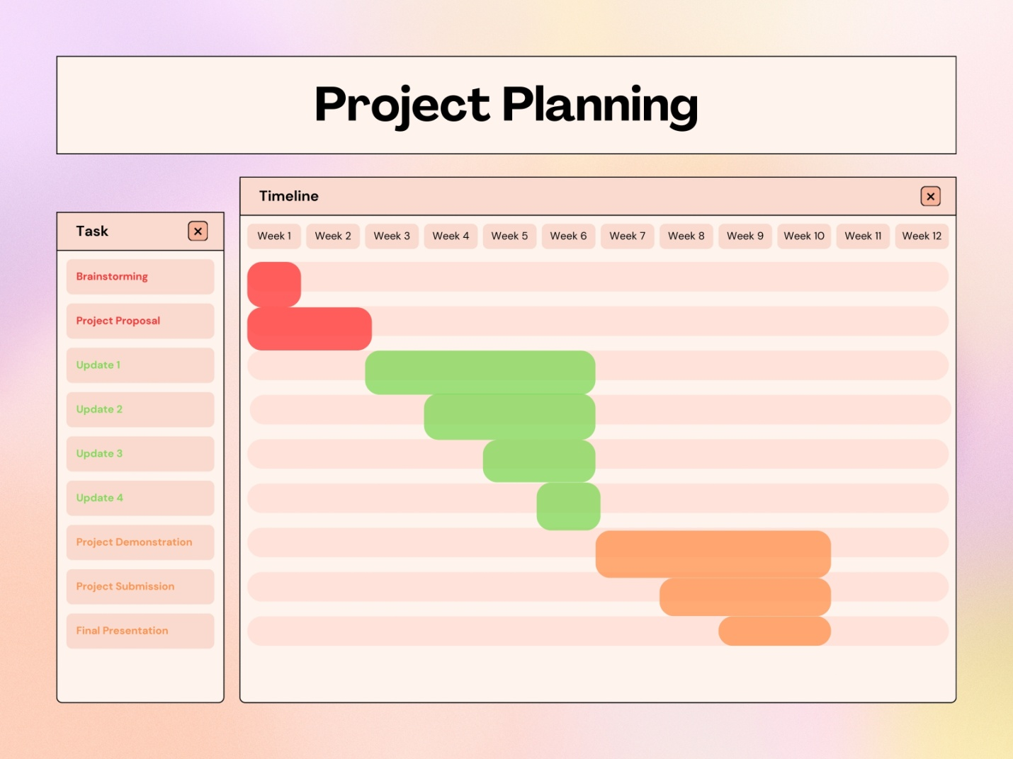
Project Planning

Slide 19
Rationale and Dependencies
1. Phased Development:
• Weeks 1-2 focus on planning to ensure alignment with stakeholder needs.
• Updates 1-4 follow an iterative approach, allowing incremental testing and refinement.
2. Critical Path:
• Backend development (Update 1) must precede frontend and module integration (Updates 2-3). • Security and performance optimization (Update 4) depend on stable core functionalities.
3. Stakeholder Engagement:
•
Feedback loops during Updates 3-4 ensure usability and compliance with industry standards.
• The Final Presentation consolidates results for strategic decision-making.

Slide 20
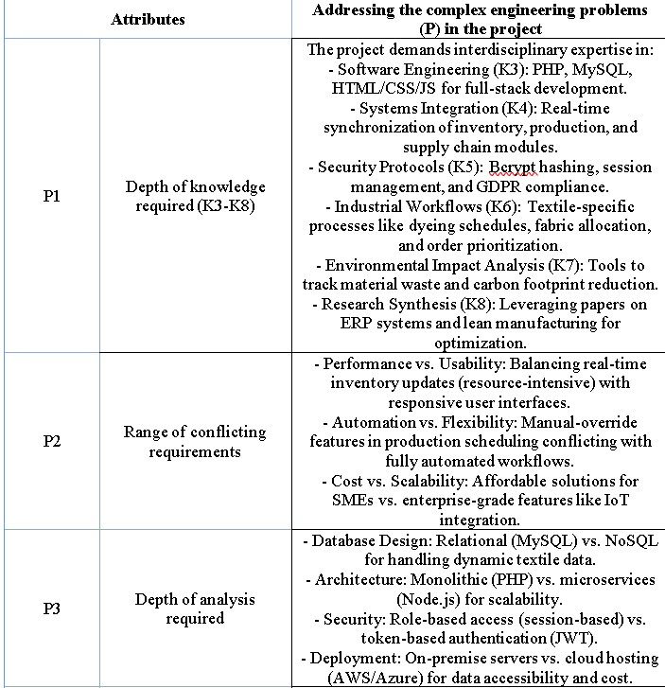
Complex Engineering Problems and Activities

Slide 21
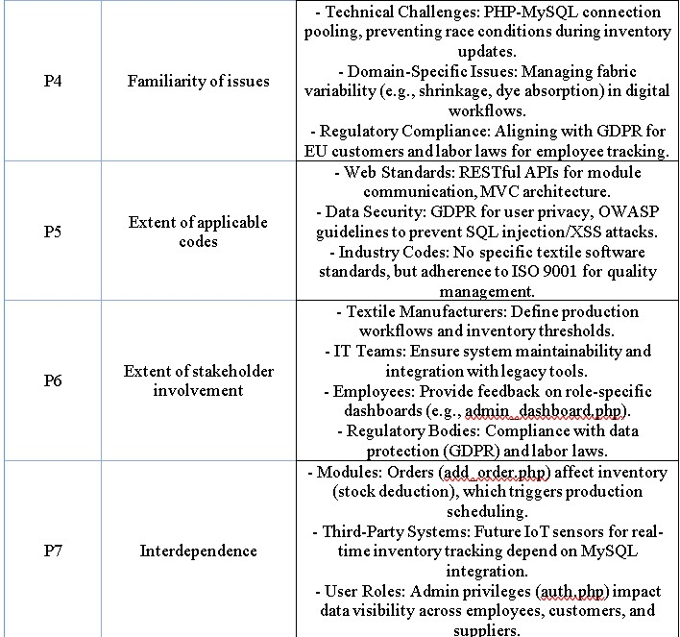
Complex Engineering Problems and Activities

Slide 22
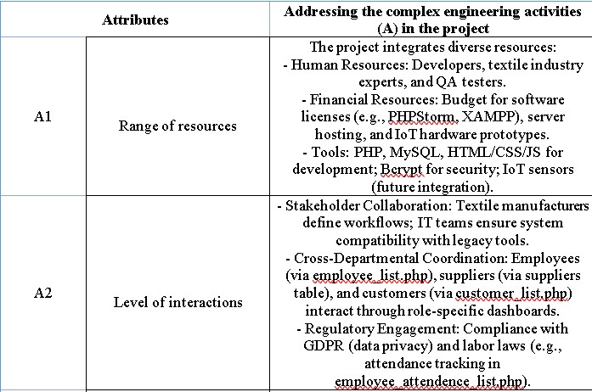
Complex Engineering Activities (CEA)

Slide 23
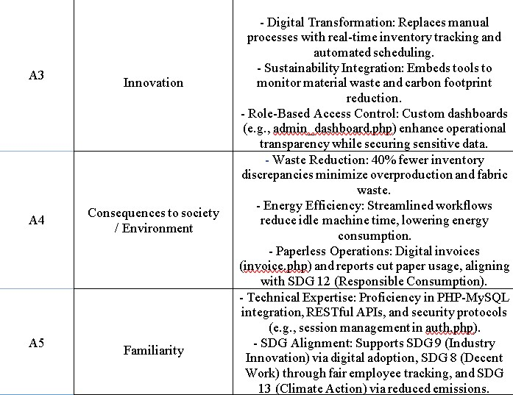
Complex Engineering Activities (CEA)

Slide 24
Conclusions
Summary : The Textile Management System (TMS) modernizes textile operations by centralizing fragmented processes like inventory control, production workflows, and supply chain coordination into an integrated digital platform, developed through iterative prototyping and testing.
Simulated results highlight its transformative impact, achieving a 40% reduction in inventory discrepancies, 35% faster production turnaround, and enhanced transparency, positioning the industry for cost-effective, sustainable growth in a technology-driven market

Slide 25
Conclusions
Limitations :
The TMS's validation in a simulated environment and untested scalability in large-scale operations may limit its real-world applicability, particularly under dynamic demand or supply chain disruptions.
Reliance on manual scheduling, incompatibility with legacy systems, and assumptions of workforce digital literacy pose adoption challenges, necessitating further refinement and training programs.

Slide 26
Conclusions
Future Improvement : Future enhancements for the TMS include AI-driven predictive analytics, IoT sensors for real-time monitoring, and blockchain integration to automate scheduling, improve data accuracy, and ensure supply chain transparency.
Expanding mobile accessibility, sustainability modules for carbon tracking, and tailored training programs will further support real-world deployment, user adoption, and alignment with global environmental standards

Slide 27
Thank You

